Slide 1

UNIT 5
FILE SYSTEM
FREE SPACE MANAGEMENT

Slide 2
Free Space Management
To keep track of free disk space, the system maintains a free-space list.
The free-space list records all free disk blocks—those not allocated to some file or directory.
To create a file, we search the free-space list for the required amount of space and allocate that space to the new file.
This space is then removed from the free-space list.
When a file is deleted, its disk space is added to the free-space list.
Approaches
Bit Vector or Bit Map
Linked List
Grouping
Counting

Slide 3
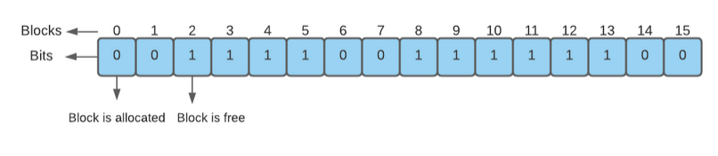
Free Space Management
Bit Vector or Bit Map
In bit vector, each block is represented by 1 bit.
If the block is free, the bit is 1;
if the block is allocated, the bit is 0.
For example, consider a disk having 16 blocks where block numbers 2, 3, 4, 5, 8, 9, 10, 11, 12, and 13 are free, and the rest of the blocks, i.e., block numbers 0, 1, 6, 7, 14 and 15 are allocated to some files.

Slide 4
Free Space Management
Bit Vector or Bit Map
We can find the free block number from the bit vector using the following method
We will now find the first free block number in the above example.
The first group of 8 bits (00111100) constitutes a non-zero word since all bits are not 0.
If it is a zero word then all bits are 0 i.e (00000000)
After finding the non-zero word, we will look for the first 1 bit. This is the third character of the non-zero word. Hence, offset = 3.
Therefore, the first free block number = 8 * 0 + 3 = 3.
(number of bits per word) × (number of 0-value words) + offset of first 1 bit.

Slide 5
Free Space Management
The advantages of the bit vector method are-
It is simple to understand.
It is an efficient method.
It occupies less memory.
The disadvantages of the bit vector method are-
For finding a free block, the operating system may need to search the entire bit vector.
To detect the first 1 in a word that is not 0 using this method, special hardware support is needed.
Keeping the bit vector in the main memory is possible for smaller disks but not for larger ones.
For example, a 1.3 GB disk with 512-byte blocks would need a bit vector of over 332 KB to track its free blocks. Giving away 332 KB just to maintain its free block space is not so efficient in the long run.

Slide 6
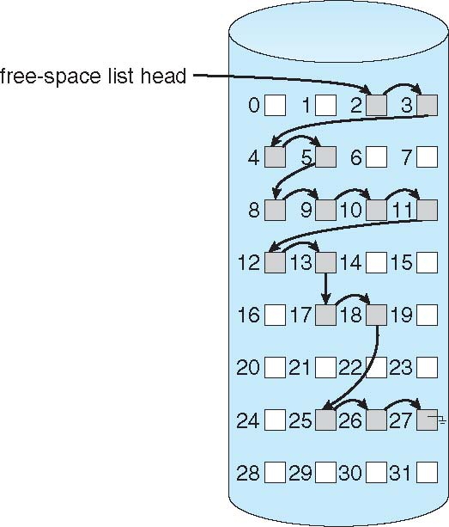
Free Space Management - Linked List
Linked List
Link together all the free disk blocks, keeping a pointer to the first free block in a special location on the disk and caching it in memory.
This first block contains a pointer to the next free disk block, and so on.
Example
Blocks 2, 3, 4, 5, 8, 9, 10, 11, 12, 13, 17, 18, 25, 26, and 27 were free and the rest of the blocks were allocated.
In this situation, we would keep a pointer to block 2 as the first free block. Block 2 would contain a pointer to block 3, which would point to block 4, which would point to block 5, which would point to block 8, and so on.
First free block which is 2 stored in memory and last free block which is 27 is set to null to indicated there are no free-blocks after this point.

Slide 7
Free Space Management - Linked List
Linked List
Cannot get contiguous space easily
No waste of space
No need to traverse the entire list (if # free blocks recorded)
This scheme is not efficient; to traverse the list, we must read each block, which requires substantial I/O time.

Slide 8
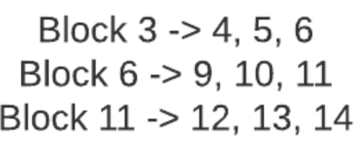
Free Space Management - Grouping
Grouping
A modification of the free-list approach stores the addresses of n free blocks in the first free block. The first n−1 of these blocks are actually free.
The last block contains the addresses of another n free blocks, and so on.
The addresses of a large number of free blocks can now be found quickly, unlike the situation when the standard linked-list approach is used.
For example, consider a disk having 16 blocks where block numbers 3, 4, 5, 6, 9, 10, 11, 12, 13, and 14 are free, and the rest of the blocks, i.e., block numbers 1, 2, 7, 8, 15 and 16 are allocated to some files.
we apply the Grouping method considering n to be 3, Block 3 will store the addresses of Block 4, Block 5, and Block 6. Similarly, Block 6 will store the addresses of Block 9, Block 10, and Block 11. Block 11 will store the addresses of Block 12, Block 13, and Block 14

Slide 9
Free Space Management - Grouping
Grouping
The advantages of the grouping method are-
The addresses of a large number of free blocks can be found quickly.
This method has the benefit of making it simple to locate the addresses of a collection of empty disk blocks.
It's a modification of the free list approach. So, there is no need to traverse the whole list.
Disadvantages
The space of one block is wasted in storing addresses. Since the nth block is used to store the addresses of next n free blocks.
We only save the address of the first free block since we are unable to maintain a list of all n free disk addresses.
There is an overhead in maintaining the index of blocks.

Slide 10

Free Space Management - Counting
Counting
In Counting, rather than keeping a list of n free disk addresses, we can keep the address of the first free block and the number (n) of free contiguous blocks that follow the first block.
Each entry in the free-space list then consists of a disk address and a count.
Thus each free block in the disk will contain two things-
A pointer to the next free block.
The number of free contiguous blocks following it.
For example, consider a disk having 16 blocks where block numbers 3, 4, 5, 6, 9, 10, 11, 12, 13, and 14 are free, and the rest of the blocks, i.e., block numbers 1, 2, 7, 8, 15 and 16 are allocated to some files.
If we apply the counting method, Block 3 will point to Block 4 and store the count 4 (since Block 3, 4, 5, and 6 are contiguous).
Similarly, Block 9 will point to Block 10 and keep the count of 6 (since Block 9, 10, 11, 12, 13, and 14 are contiguous)

Slide 11
Free Space Management - Counting
Advantages
The advantages of the counting method are-
Fast allocation of a large number of consecutive free blocks.
Random access to the free block is possible.
The overall list is smaller in size.
Disadvantages
The disadvantages of the counting method are-
Each free block requires more space for keeping the count in the disk.
For efficient insertion, deletion, and traversal operations. We need to store the entries in B-tree.

Slide 12
THANK YOU

